Slide 1
EVALUATION PROPOSAL FOR THE
2SLGBTQ+ Youth Program
Prepared for: Winnipeg Rainbow Resource Centre
CESEF Student Case Competition
June 13, 2022

Slide 2
Land Acknowledgement
We respectfully acknowledge the unceded traditional territories including, the Sḵwx̱wú7mesh Úxwumixw (Squamish), səl̓ilw̓ətaʔɬ (Tsleil-Waututh) and xʷməθkʷəy̓əm (Musqueam) Nations that we live on uninvited in Vancouver.
Today, we are located on the original lands of Anishinaabeg, Cree, Oji-Cree, Dakota, and Dene peoples, and on the homeland of the Métis Nation.

Slide 3
Meet our team
Jenna Bentley (she/her)
Reem Mustafa
(she/her)
Blaga Ivanova (she/her)
Samer Rihani
(he/him)
Sadie Stephenson
(she/her)

Slide 4
Program Overview
Logic Model
Stakeholder Engagement
Proposal Outline
Our Approach
Data Collection Methods
Analysis
Evaluation Matrix
Knowledge sharing plan
Our Timeline
Anticipated Challenges + Mitigation

Slide 5
Programs for a broad spectrum of 2SLGBTQ+ communities
The Centre runs many programs for 2SLGBTQ+ communities in Winnipeg
Our Understanding
Camp Aurora
Counselling
Education
Library
Over the Rainbow for 2SLGBTQ+ older adults,
Social support groups
2SLGBTQ+ Youth Program, drop-in activities for youth aged 10-21.
The Rainbow Resource Centre

Slide 6
Program Overview
Key Activities
Vision
A society in which diverse sexual and gender identities, orientations and expressions are included, valued, and celebrated.
Mission
Rainbow Resource Centre nurtures inclusive spaces for 2SLGBTQ+ communities to thrive.
Youth Program
Youth Program Aim
Youth Program is for 2SLGBTQ+ and allied youth, ranging in ages from 10-21, and offers a positive space to celebrate identity.
Youth Program focuses on fostering resilience, increasing self-esteem, confidence and skills while building social networks, contacts, and peer support.
Notes:
Rainbow Resource Centre. About us [Internet]. Winnipeg;2022 [cited 2022 Jun 13]. Available from: https://rainbowresourcecentre.org/about

Slide 7
Stakeholder Engagement
Primary:
Consulted on a regular basis.
Engaged first-hand in the evaluation process of the program.
Aids in implementation and operation of new data collection methods.
Secondary:
Support ongoing evaluation & sustain uptake of 3-year plan.
Tertiary:
Results will be disseminated to inform program operations, evaluation process, and knowledge translation opportunities.
Primary
2SLGBTQ+ Youth Participants in Programs
Rainbow Resource Centre Youth Program Staff & Volunteers
Secondary
Tertiary
Local Communities
United Way
Board of Directors
Families of LGBTQ+ Youth
Elders
2SLGBTQ+ Youth in Programs
Research & Educational Institutions
Child & Family Services (Manitoba)
Policy Makers

Slide 8
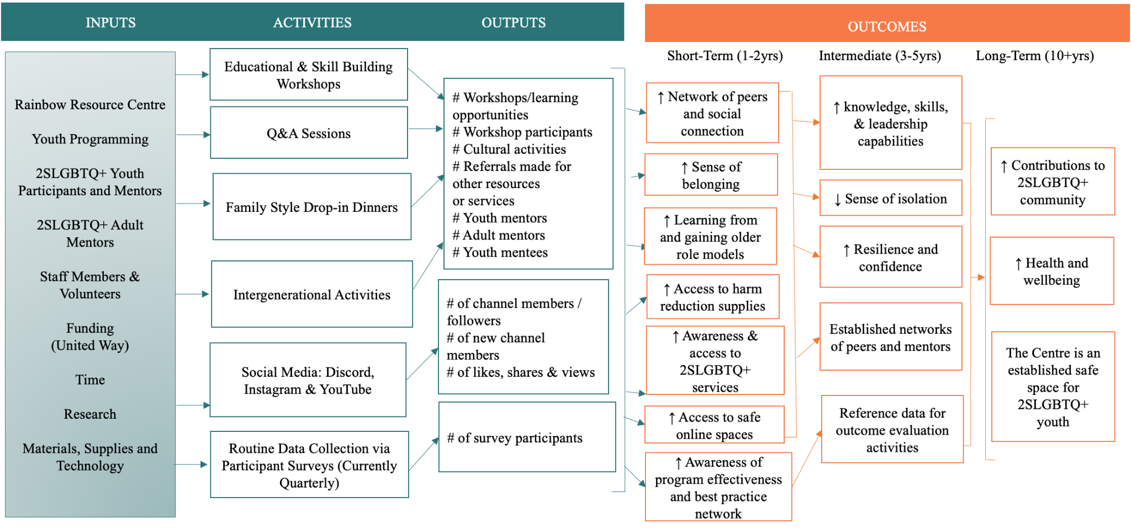
Logic Model
Notes:
Rainbow Resource Centre. About us [Internet]. Winnipeg;2022 [cited 2022 Jun 13]. Available from: https://rainbowresourcecentre.org/about

Slide 9
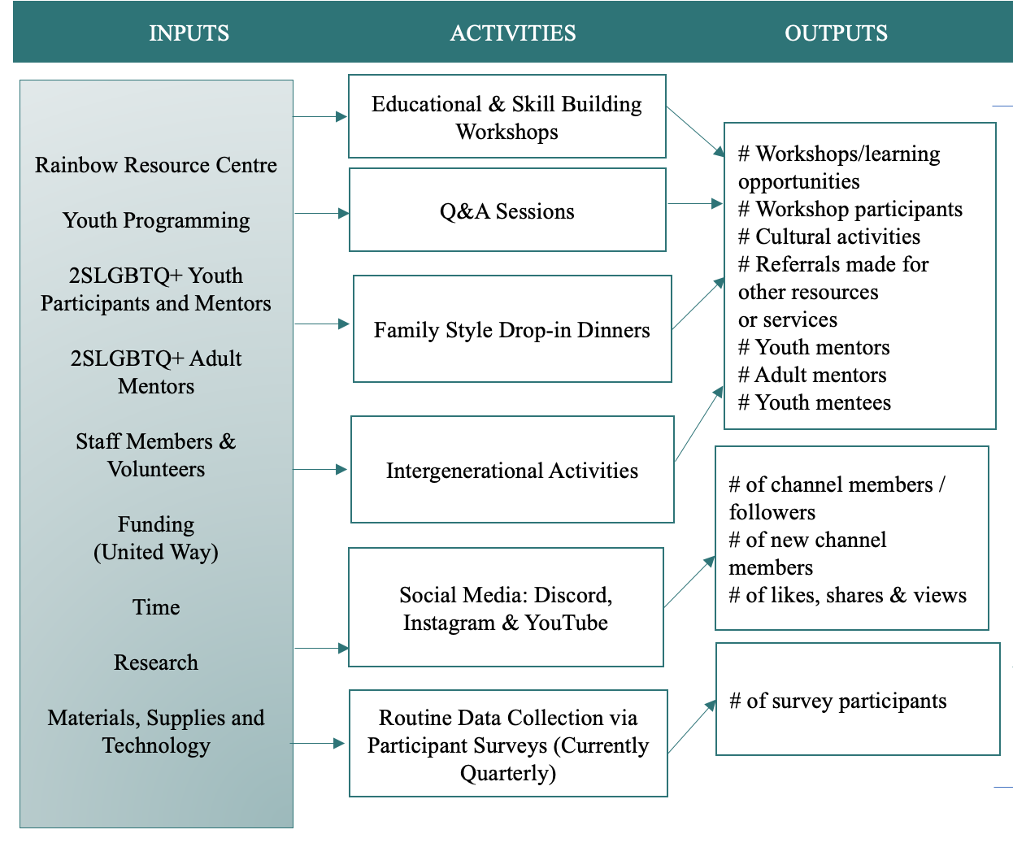
Notes:
Rainbow Resource Centre. About us [Internet]. Winnipeg;2022 [cited 2022 Jun 13]. Available from: https://rainbowresourcecentre.org/about

Slide 10
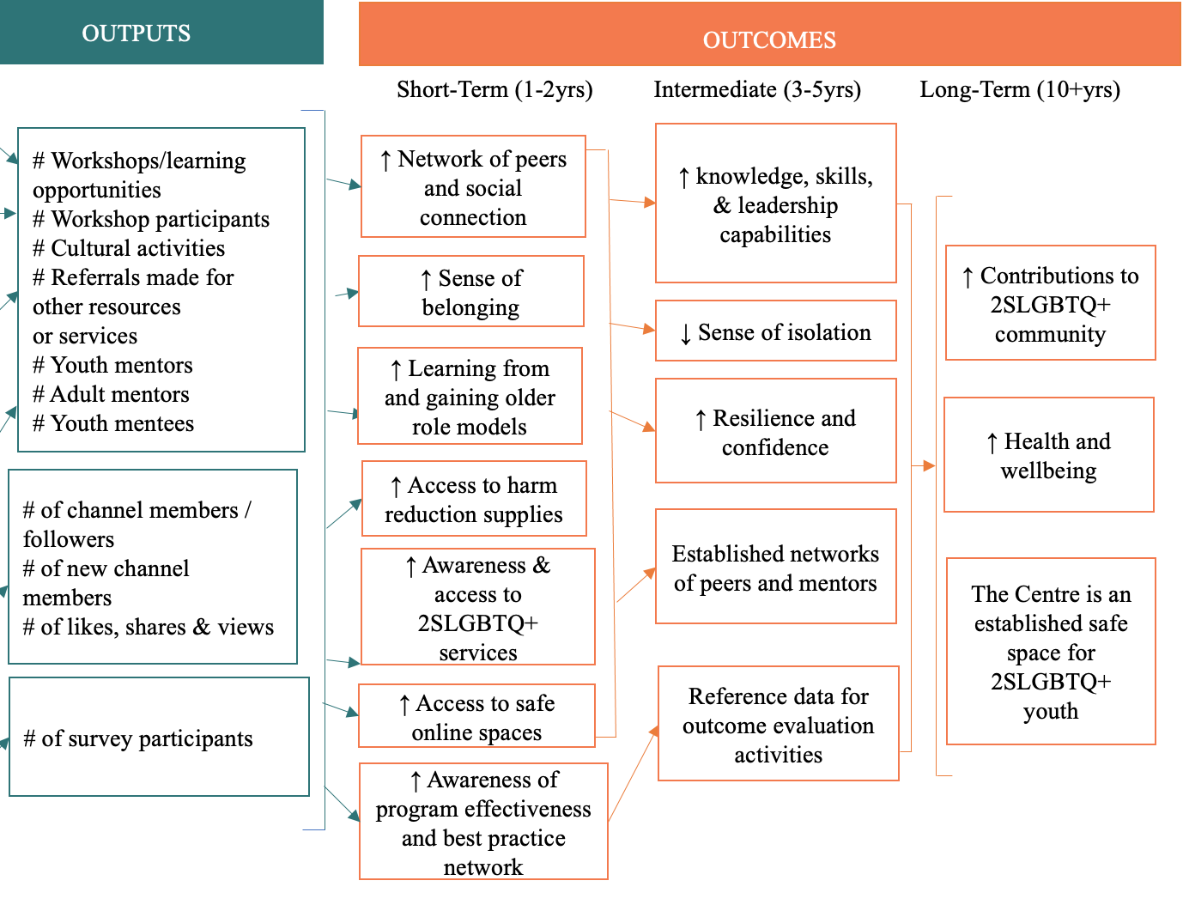
Notes:
Rainbow Resource Centre. About us [Internet]. Winnipeg;2022 [cited 2022 Jun 13]. Available from: https://rainbowresourcecentre.org/about

Slide 11
Assumptions, Risks, and External Factors
Assumptions
Youth are willing to engage in the evaluation
The program continues to secure resources and funding from United Way
Two-spirit leaders and/or Elders, BIPOC leaders, and 2SLGBTQ+ leaders are able to assist in facilitation
External Factors
Adaptation to public health measures (e.g. social distancing to limit communicable disease during COVID, avoiding outdoor travel during heatwaves)
Shifting guidelines and potential new direction from evidence
Changes to provincial and/or federal landscape to 2SLGBTQ+ structures, rights, and policies
Risks
Loss of resources and funding from United Way or other potential funding bodies
Lack of community support

Slide 12
Our Evaluation Approach
Utilization-Focused and Collaborative/Participatory
Youth-Informed
Acknowledges and incorporates the unique needs of youth.
Key focus is usability among the intended users. Facilitates inclusivity and participation.
Indigenous Engagement
Diversity and Inclusion
“Nothing about us without us” approach
Winnipeg has the most concentrated population of Indigenous people in an urban centre Canada.
Notes:
Reyner A, Matties Z. Indigenous People of Manitoba A guide for newcomers: A resource guide compiled by Anika Reynar and Zoe Matties for Mennonite Central Committee Manitoba [Internet]. Winnipeg; 2015 [cited 2022 Jun 13]. Available from: https://www.immigratemanitoba.com/wp-content/uploads/2016/07/indigenousguide-web-version2b.pdf

Slide 13
The Last 5 Years
Survey & Attendance Analysis
Results from the survey will be assessed to identify program successes and challenges. Program activities participation data will also be analyzed to identify trends.
Key Informants Interviews (KII)
A total of four key informant interviews will be conducted with the Youth Program, BIPOC Youth Program, the Participant Support Coordinators, and the Executive Director.
Social Media Analytics
Website analytics will be used to identify popular channels, and their traits, in order to improve those that are less visited and identify trends.
Youth Advisory Committee (YAC)
Formation of a Youth Advisory Committee, consisting of 8-10 engaged participants. Consultations with the YAC will be used to inform survey improvements and program impact.

Slide 14
Children (10-13 yo)
‘My life Timeline ‘ (MLT) drawing sessions will be conducted to identify desired life trajectories & where program services supports fall into them.
Future Steps & Capacity Building
Teens (14-16 yo)
Similar to the MLT sessions above, the facilitation of these sessions will be tailored to this age group’s interests and used to pinpoint how program services can help participants achieve their goals.
Informed by the Youth Advisory Committee and findings from the staff Key Informant Interviews
* Programming is adaptable and will be based on findings from Step I
Young Adults (17-21 yo)
Focus Groups consisting of 5-7 participants will be conducted to capture youth’s perspectives on the operations and impact of the program. Community based 2SLGBTQ+ elders and leaders will be facilitating the sessions based on group demographics.
Acronyms: yo : years old; MLT: My life timeline
Notes:
References: Hieftje, K., Duncan, L. R., & Fiellin, L. E. (2014). Novel methods to collect meaningful data from adolescents for the development of health interventions. Health promotion practice, 15(5), 714–722. https://doi.org/10.1177/1524839914521211

Slide 15
Data Analysis
Key Informant Interviews & Focus Groups
Thematic Analysis will be conducted on findings from the initial KII, MLTs and FGs. Emergent themes will be identified following an interactive process of triangulation between our team of experts. Themes arising from MLTs and focus groups conducted after our team’s evaluation will be identified by program coordinators.
Survey & Participant Data Analysis
Statistical software (such as R and excel) will be used to analyze current aggregate data. Qualtrics will be utilized in future surveys for data collection and analysis. Social platform analytics we’ll also be imported for the five-year period.

Slide 16
Evaluation Matrix
Evaluation Question | Indicator | Data Source | Data Collection
Has the 2SLGBTQ+ Youth Program been reaching and benefiting youth as intended within the last 5 years?
1.1) How does the Youth Program affect participating youth? | # of youth accessing the in-person services. # of youth using virtual channels and services. Feedback provided in the Key Informant Interview (KII) sessions. Feedback in the dialogue sessions with youth. | Youth Volunteers/staff Rainbow Resource Centre Leadership Aggregate participation data collected | Document review & analysis Retrospective data breakdown Brainstorming focus groups “Life timeline” sessions
1.2) What are the barriers and facilitators of the program and better engaging and supporting youth? | Barriers and facilitators experienced by participants mentioned directly via feedback (whether online or in-person). Various channels (such as Discord) to provide anonymous feedback. Changes identified in the retrospective data. | Youth Staff/Volunteers Rainbow Resource Centre Leadership Youth Advisory Committee members (YAC) | YAC scheduled meetings and roundtable dialogue Staff/Volunteer focus groups KIIs with leadership Youth survey (informed by results of focus groups) Data analysis from last 5 years
1.3) Is the Youth Advisory Committee representing and benefitting the collective wellbeing of all youth? | Number of seats per sub-group within the entire program (ex. Age groups 13-16, 17-21, as well as BIPOC youth, etc.) Collective ongoing feedback within meetings. | Youth Advisory Committee members (YAC) Staff/Volunteers | Document review & analysis Preliminary focus groups with the YAC
1.4) Are staff and volunteers able to successfully carry out the program? | Staff and volunteer feedback on how they are feeling around training and preparation. Feedback provided in the Key Informant Interview (KII) sessions. | Staff/Volunteers Rainbow Resource Centre Leadership | Staff/Volunteer focus groups KIIs with key staff and leadership

Slide 17
Evaluation Matrix
Evaluation Question | Indicator | Data Source | Data Collection
How effective is the 2SLGBTQ+ Youth Program in fostering resilience and creating a sense of community? Including accessibility, inclusivity, comprehensiveness, and equity.
2.1) How effective is the program in allowing youth to celebrate identity and increase self-esteem? From both an individual and social perspective. | Youth-focused program feedback from dialogue (around program overall). Youth satisfaction reported on: Care provided in the program. Respect from staff and fellow youth. Inclusivity and a sense of belonging. Participation rates from youth in specific minority communities (Indigenous, those living with a disability, etc). | Youth (current) Self-identified youth who belong to a minority group. Youth (who used the program in the last 5 years) Staff/Volunteers | Document review & analysis Brainstorming focus groups Survey Data Analysis Online platforms for youth to provide feedback
2.2) How applicable is the program in promoting equity, diversity, and inclusion? | Diversity of members representing youth on the Youth Advisory Committee. Various channels (such as Discord) open to youth to provide anonymous feedback. Changes identified in the retrospective data. Invitation to community members with lived experiences (ex. Two-spirit Elders) | Youth Staff/Volunteers Rainbow Resource Centre Leadership Youth Advisory Committee members (YAC) | Document review & analysis EDI-related questions in survey/focus groups Data analysis from last 5 years Online platforms for youth to provide feedback

Slide 18
Evaluation Matrix
Evaluation Question | Indicator | Data Source | Data Collection
How will the 2SLGBTQ+ Youth Program build capacity over the next 3 years?
3.1) Are youth perspectives actively being used to shape the structure of the program? | Active retainment and consultation with the youth groups and YAC over the next 3 years. # of youth continuing to access virtual channels and services. # of youth continuing to access in-person programs and services. Feedback in the dialogue sessions with youth. | Youth Volunteers/staff Rainbow Resource Centre Leadership Youth Advisory Committee members (YAC) | Document review & analysis Brainstorming focus groups “Life timeline” sessions
3.2) Is there adequate resourcing available to support the sustained delivery of the youth program? | Barriers and facilitators experienced by youth leaders directly via dialogue (whether online or in-person). Various channels (such as Discord) open to youth to provide anonymous feedback. Key deliverables on program efficacy and benefit to United Way leadership. | Youth Staff/Volunteers Rainbow Resource Centre Leadership United Way Youth Advisory Committee members (YAC) | YAC scheduled meetings and roundtable dialogue. Staff/Volunteer focus groups KIIs with leadership Youth survey (informed by results of focus groups) Data analysis from last 5 years
3.3) Are staff and volunteers able to successfully carry out the program? | Staff and volunteer feedback on how they are feeling and if they believe they are adequately trained and prepared to carry out this program. Staff feedback on program delivery and wellbeing of the staff and volunteers. | Staff/Volunteers Rainbow Resource Centre Leadership | Staff/Volunteer focus groups KIIs with key staff and leadership

Slide 19
1-3-25 report
1 page: Outline of key findings
3 pages: Executive Summary
25 pages: Detailed findings, methodology and a 3-year roadmap for evaluation capacity building
Knowledge Sharing Plan
Infographic
A one-page infographic that summarizes our findings on program impact and effectiveness of data collection strategies targeted towards youth and community members. Will be disseminated on RRC’s website and social media channels.

Slide 20
Timeline
Creation of Youth Advisory Committee (YAC)
Analysis of Qualitative and Quantitative Data
Data Collection from Program Participants
4 Key Informant Interviews
Evaluation Report and 3-year Plan
Ongoing, iterative feedback from stakeholders

Slide 21
 | July 2022 |  |  |  | August 2022 |  |  |  | September 2022
Week | 1 | 2 | 3 | 4 | 5 | 6 | 7 | 8 | 9 | 10 | 11 | 12
KIIs (Youth Program Staff)
Creation of YAC - Program participants
Consultation with YAC
Development of data collection tools
Secondary, youth-informed data collection
Qualitative and quantitative data analysis
Evaluation Report submission

Slide 22
Anticipated Challenges and Mitigation
Data collection strategies have struggled to effectively engage youth
Lack of resources to execute the 3-year evaluation plan
Scope Creep
Challenge
Youth Advisory Committee (YAC)
Incentives for participants
Leadership/network opportunities
Diverse representation in facilitators
Communication plan to engage with stakeholders to outline funding needs
Flexible timelines to adapt to current RRC priorities
3 year evaluation plan is a living document
Clear deliverables established at outset
Key dates and deadlines from RRC outlined
Regular check-ins and meetings with RRC
Mitigation Strategy
High Severity
Moderate Severity
Low Severity
Notes:
Describe colors as likelihood assessment

Slide 23
Thank You
for Listening

